Slide 1
ENGG104 Electrical Systems
Lecture 4
Introductory Circuit Analysis, Boylestad, 12th Ed
Attribution Nidhal Abdulaziz

Slide 2
Lecture 3 summary
Parallel Circuits
Kirchhoff's Current Law (KCL) - all currents in and out of a node sum to zero.
Current Dividers – current splits in proportion to resistance

Slide 3
Lecture 4 Outline
Boylestad – Chapters (7 and 8 )
Series/Parallel Circuits
The current source
Current/voltage source conversion
Nodal analysis

Slide 4
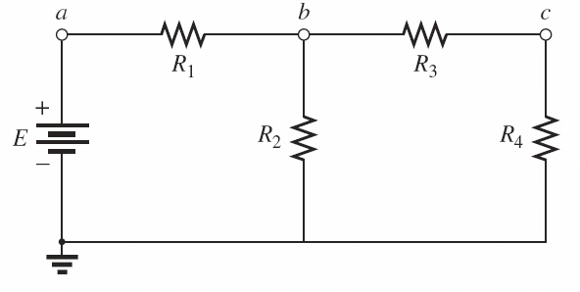
Series/Parallel Circuits
A series-parallel configuration is one that is formed by a combination of series and parallel elements.
Note: R₃ in series
with R₄. Together
They are in
Parallel with R₂.
All of them are
In series with R₁
FIG. 7.1 Series-parallel dc network.

Slide 5
From the previous slide – Reduce and Return
R’=R₃+R₄ (series)
R’_{T}=R₂//R’ (parallel)
R_{T} = R’_{T}+R₁
Now we can determine I_{s}
Then use current divider
To determine branch currents
Or Voltage divider

Slide 6
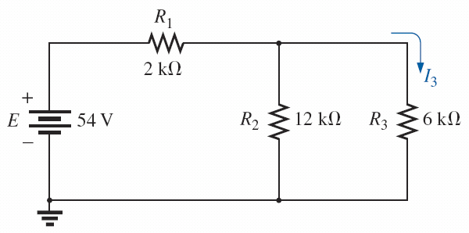
Example 1
Determine I₃
Hint: only use voltage divider without
Determining source current.
FIG. 7.3 Series-parallel network for Example 7.1.

Slide 7
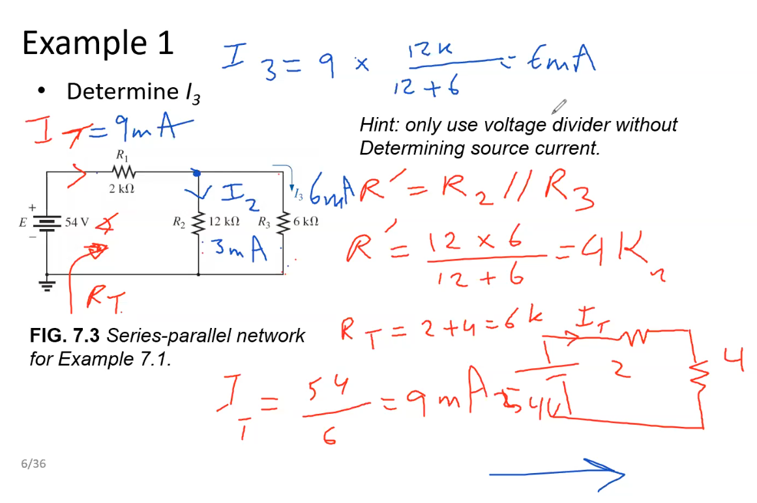

Slide 8
Example 2
Determine I₄, V₂ and I_{s} in this order

Slide 9
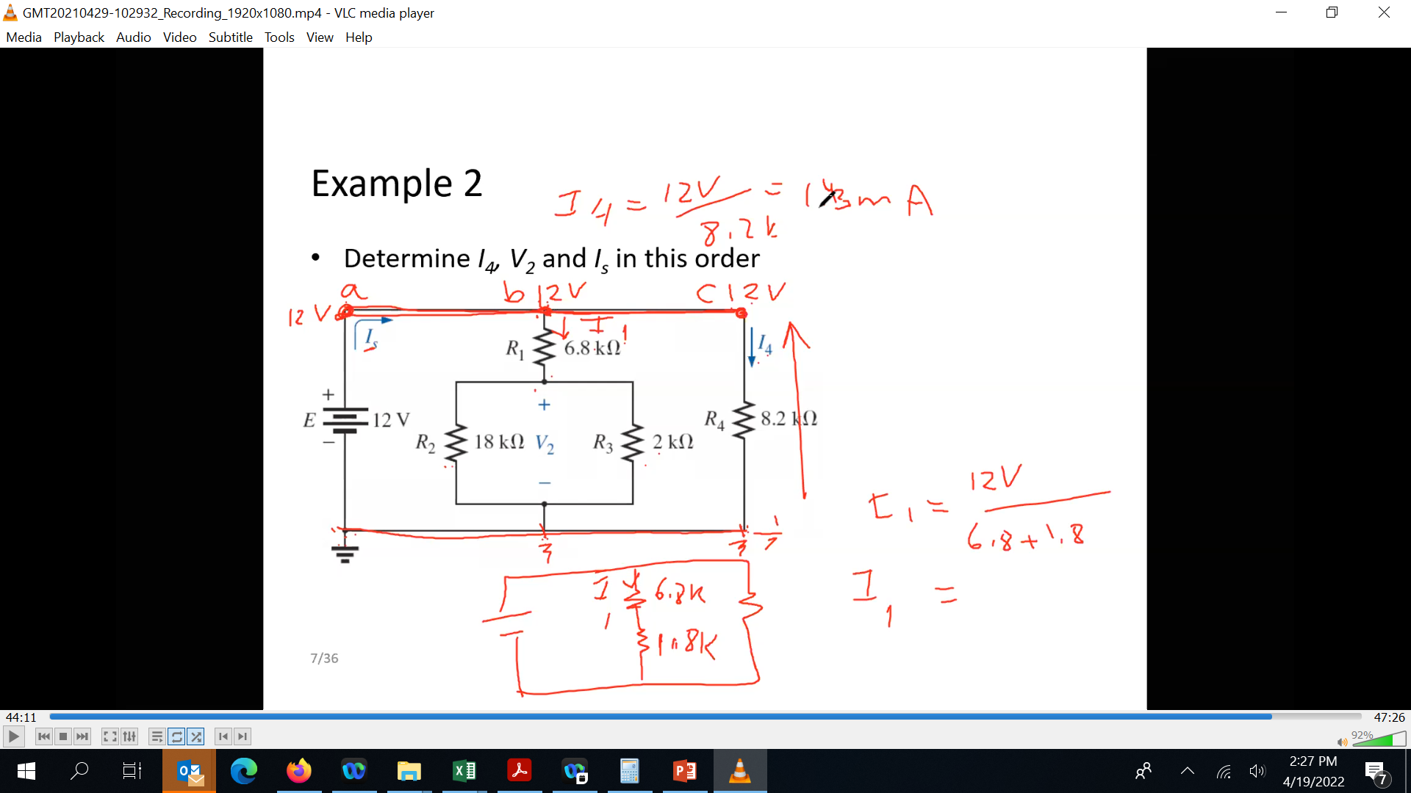
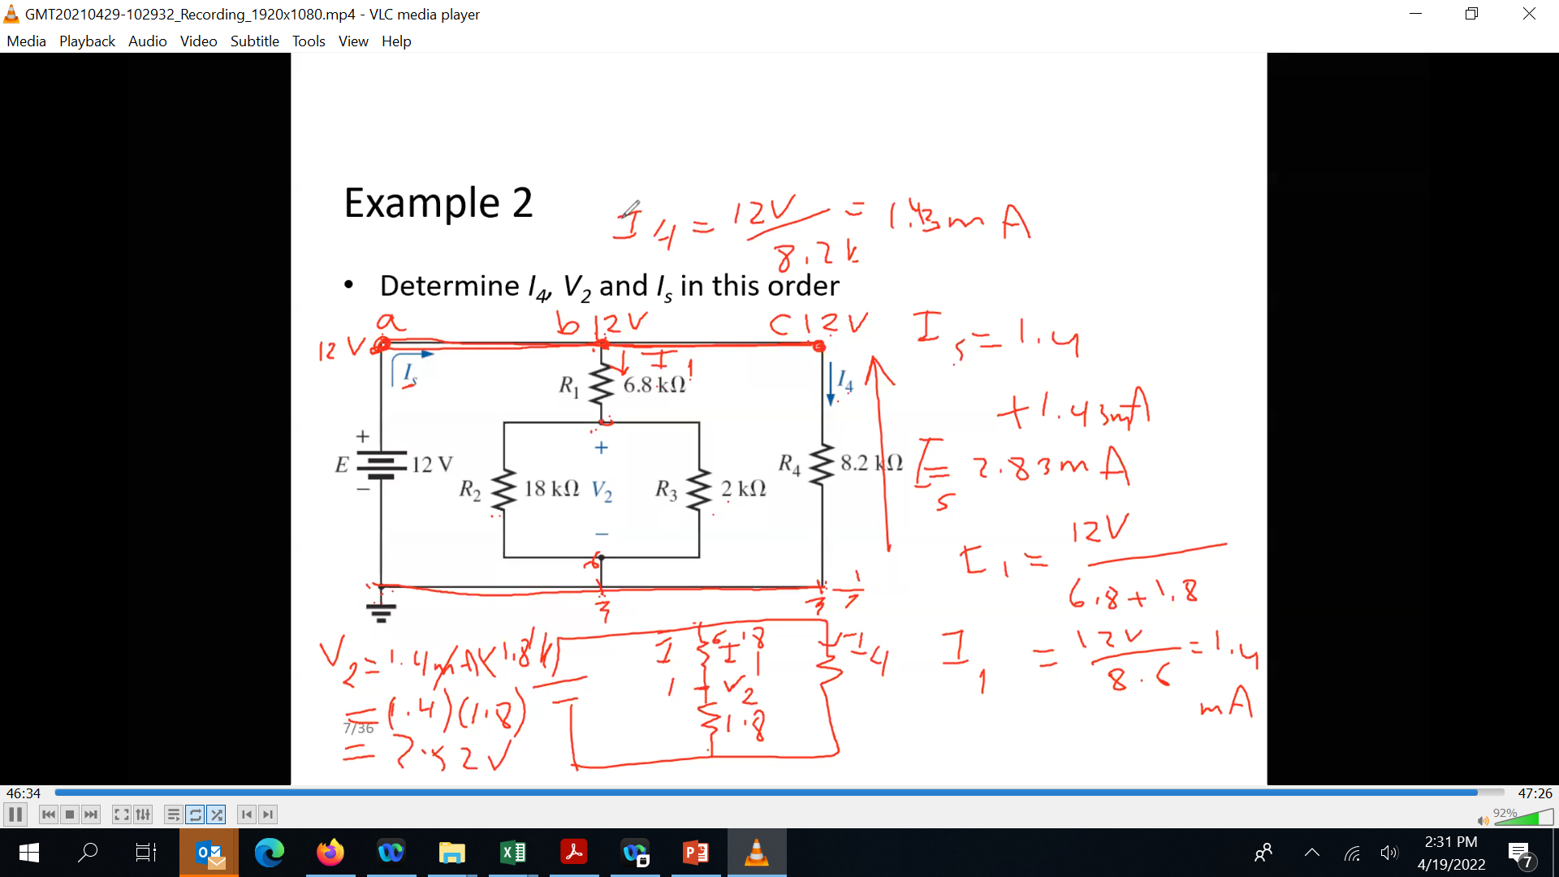

Slide 10
Another example
Determine currents

Slide 11
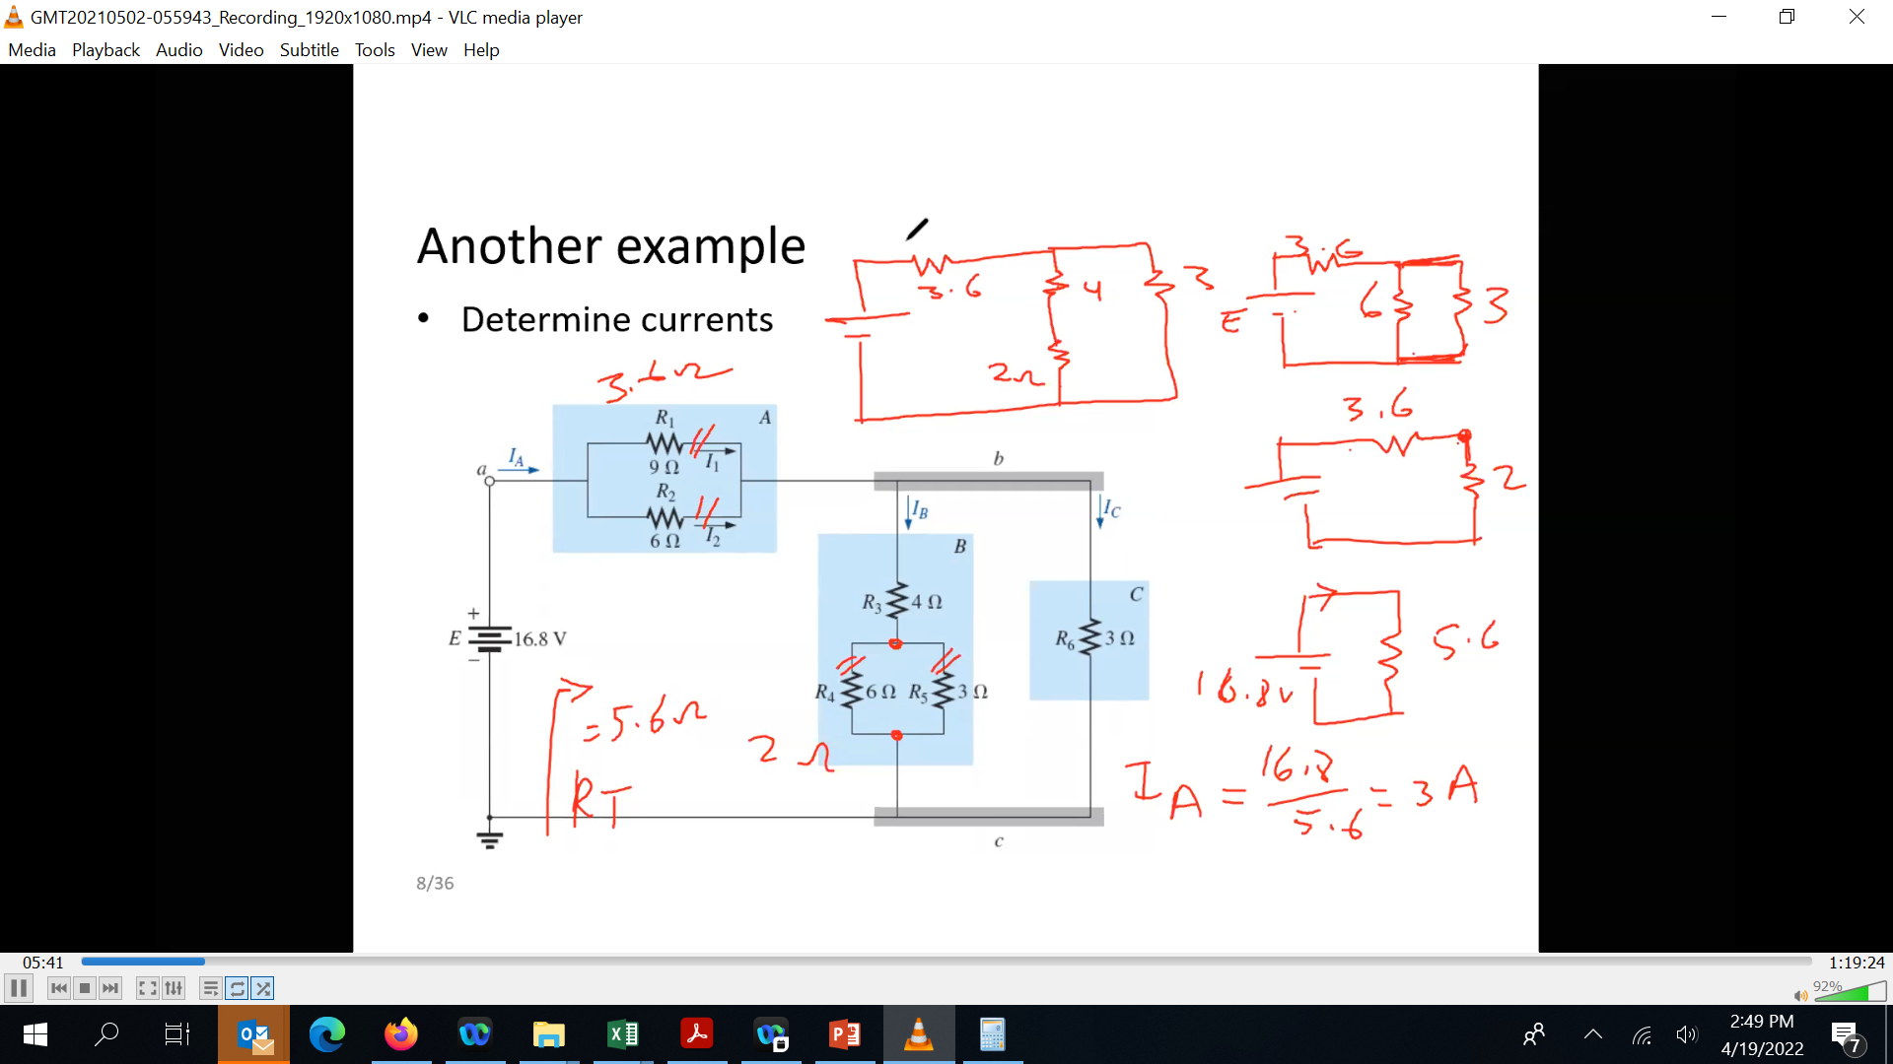
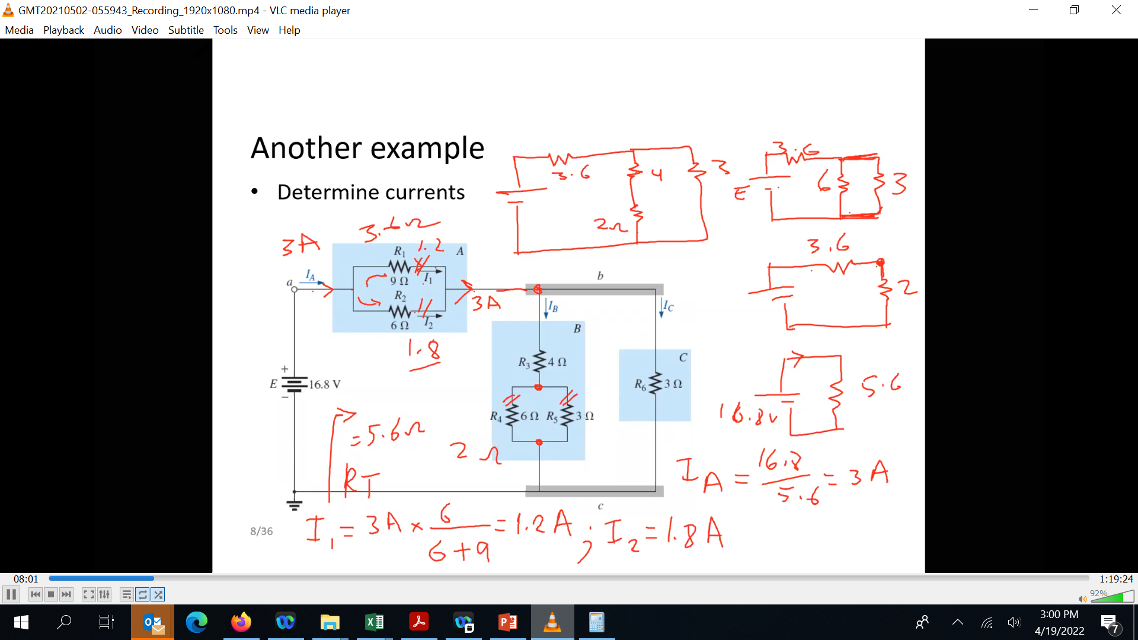

Slide 12
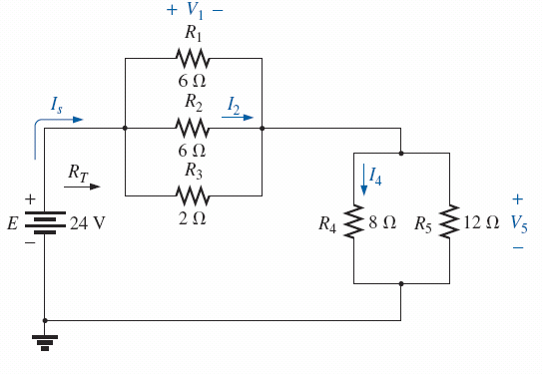

Typical exam question
Determine the unknowns

Slide 13
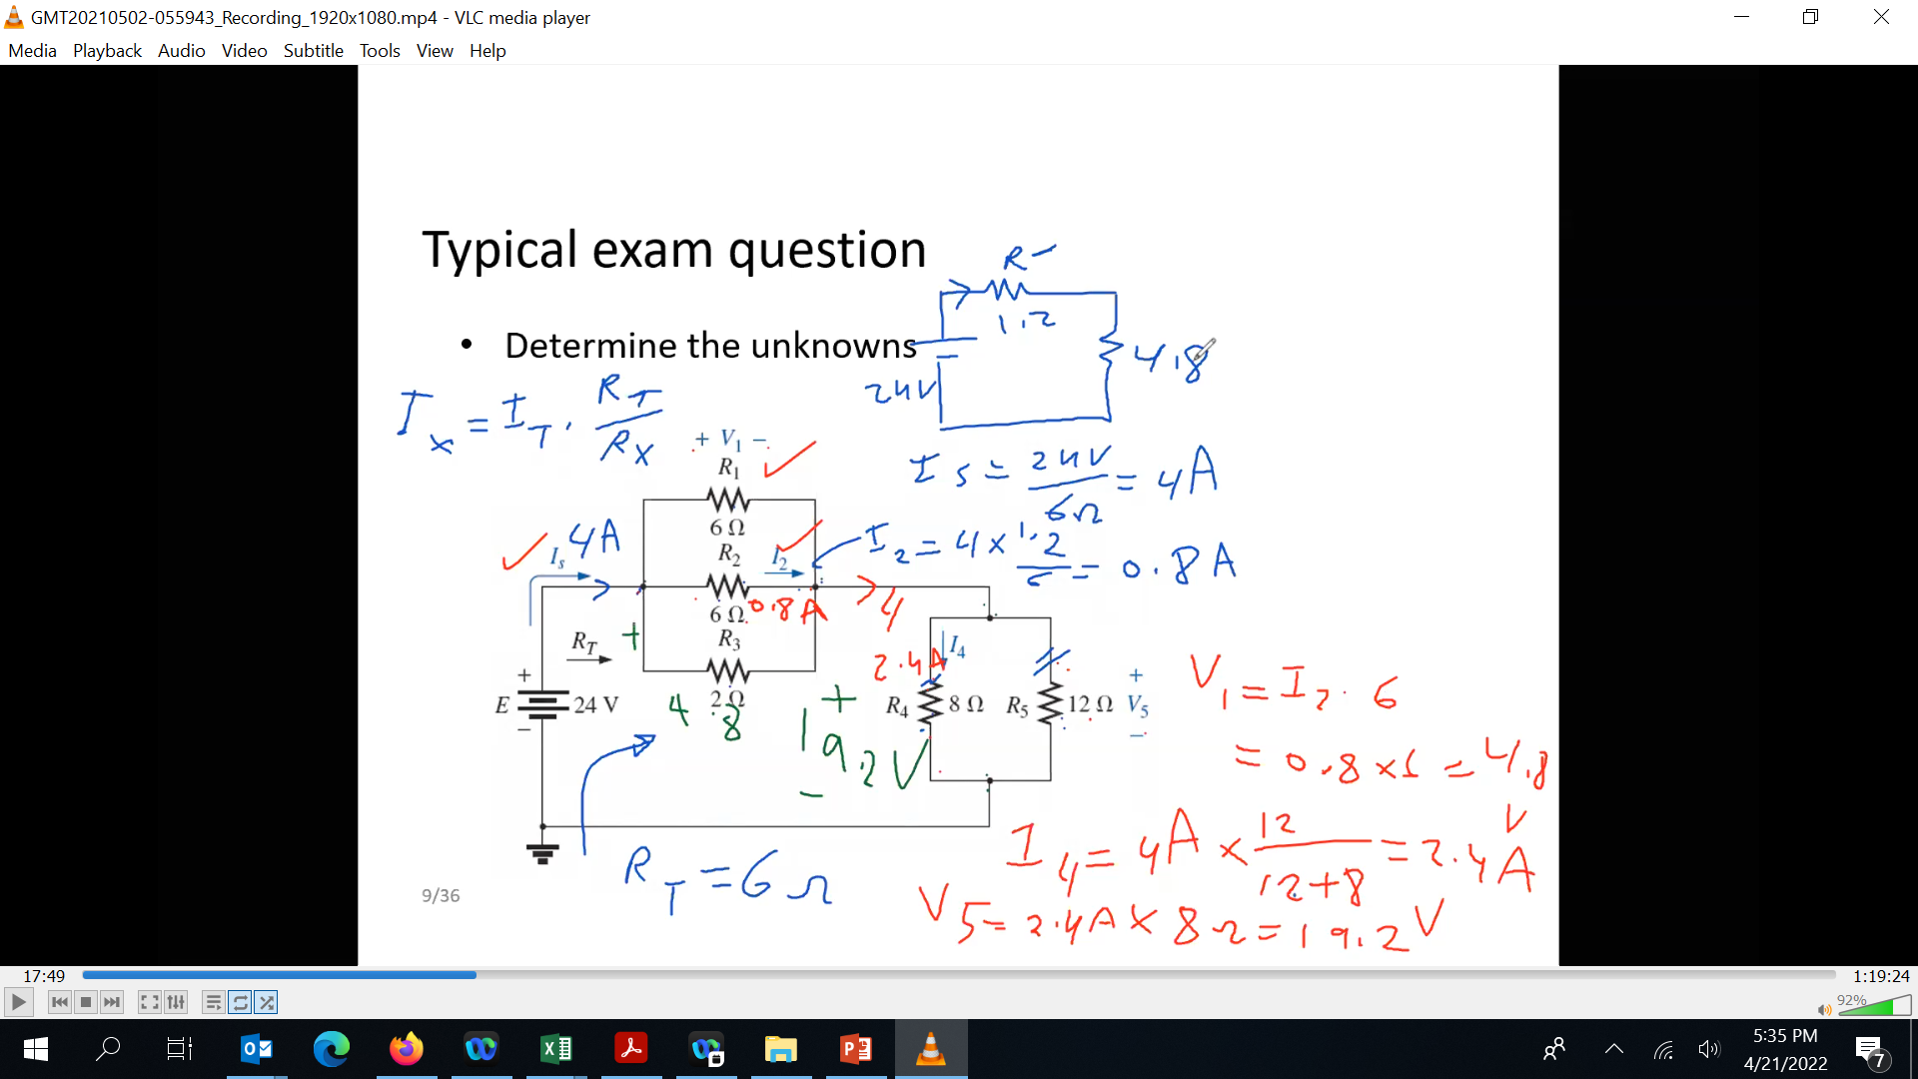

Slide 14
Challenge 1
Much easier than you think ☺
FIG. 7.22 Example 7.8.

Slide 15
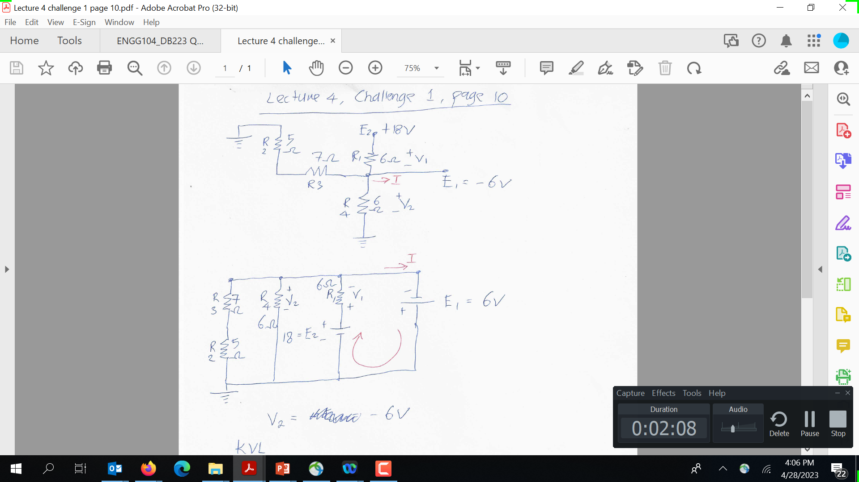
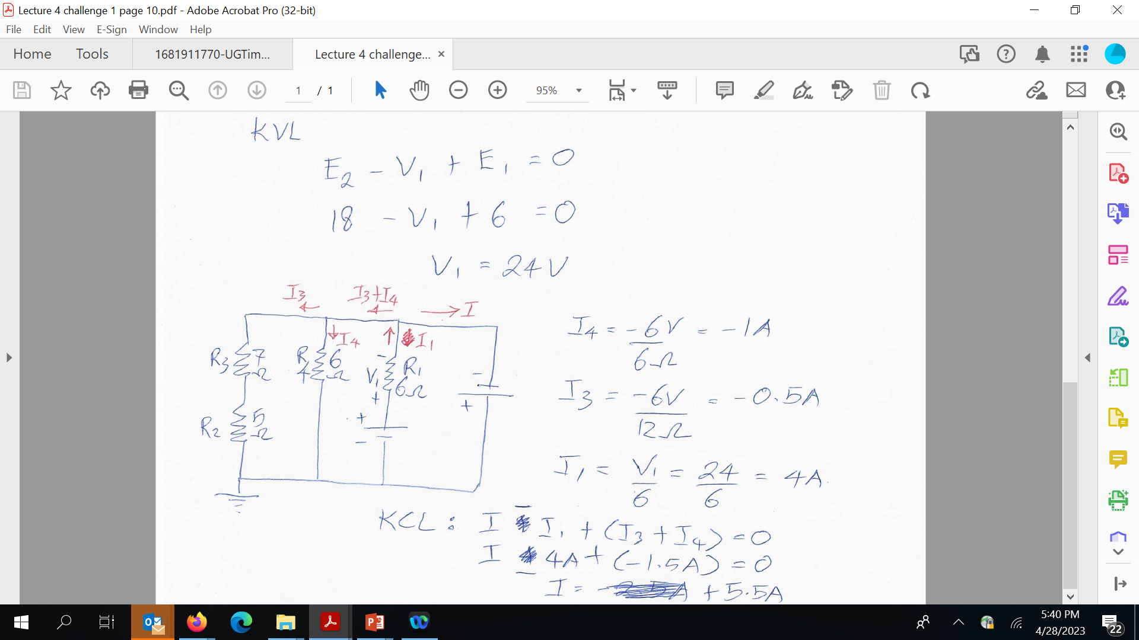

Slide 16
Current Sources
Although current sources are available as laboratory supplies, they appear extensively in the modeling of electronic devices such as the transistor.
Just as a battery provides a fixed voltage to a network, a current source establishes a fixed current in the branch where it is located.
FIG. 8.1 Introducing the current source symbol.

Slide 17
Current Sources
In general, a current source determines the direction and magnitude of the current in the branch where it is located.
Furthermore, the magnitude and the polarity of the voltage across a current source are each a function of the network to which the voltage is applied.

Slide 18
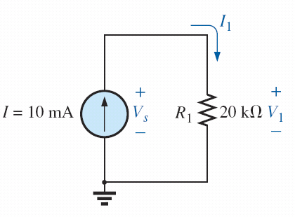
Example
Current I₁ will always be 10 mA in the branch where the current source is
V₁ = 10mA x 20KΩ = 200V
(Ohms law V=IR)
What’s V_{s}?
FIG. 8.2 Circuit for Example 8.1.

Slide 19
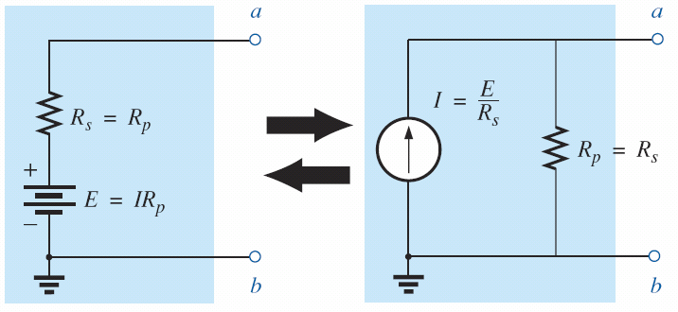
Source Conversion
FIG. 8.6 Source conversion.

Slide 20
Source Conversion Example
What’s I_{L} in both circuits? What is the V_{L} in both circuits?

Slide 21
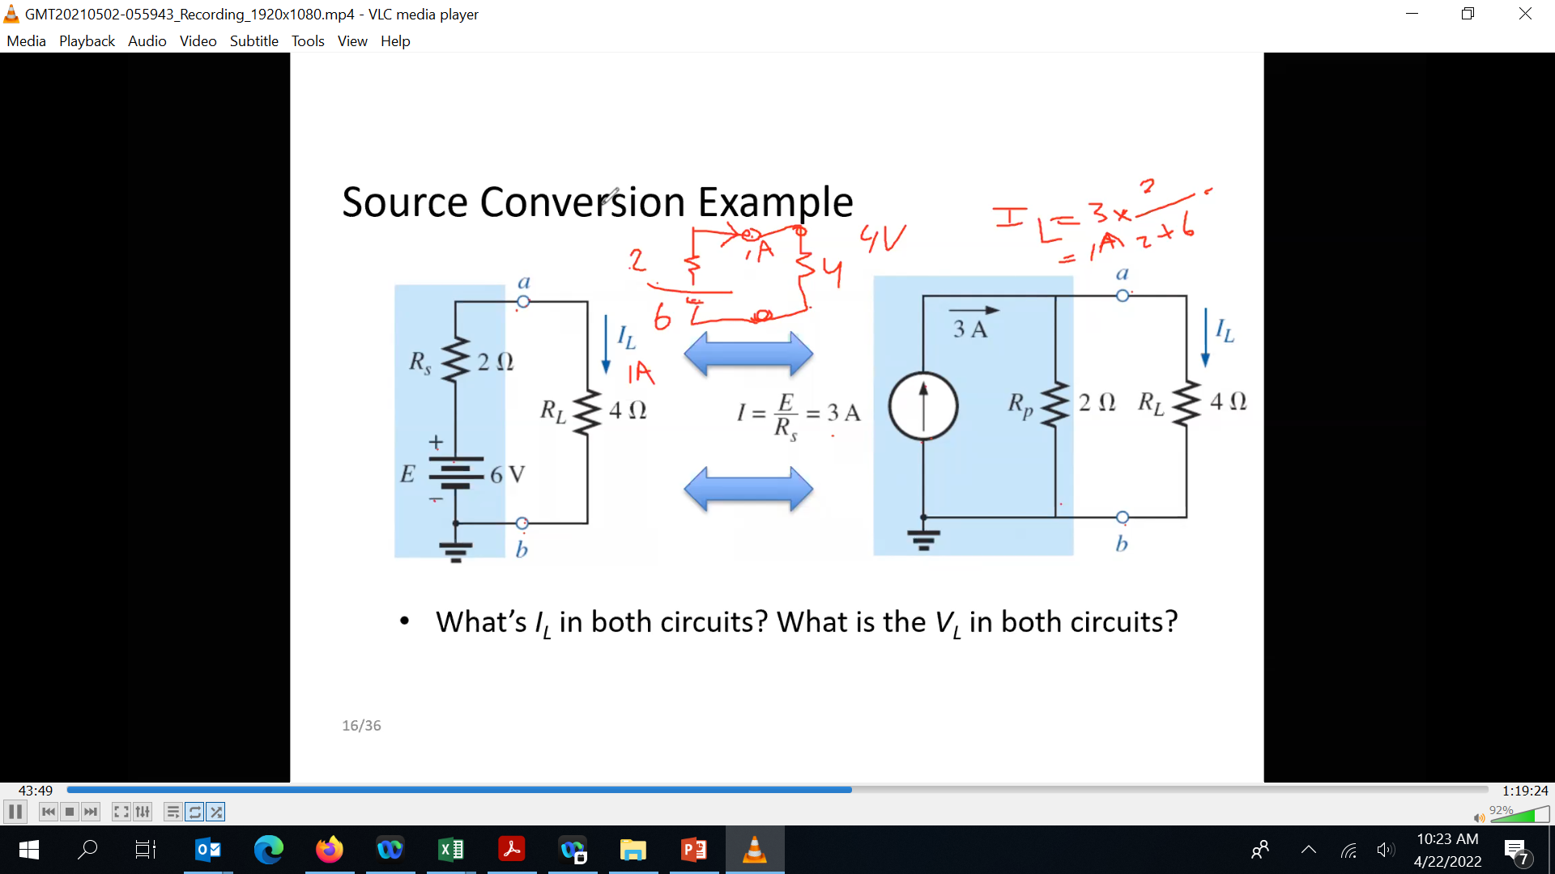

Slide 22
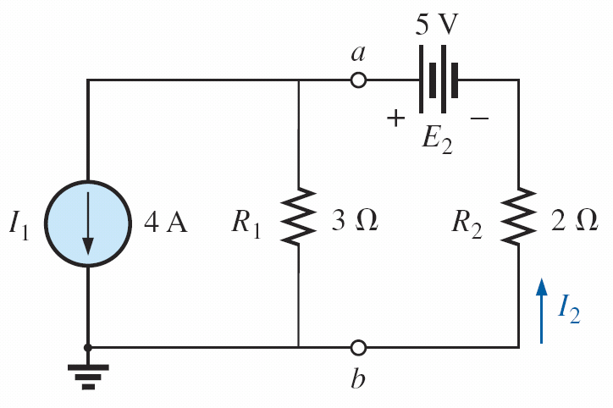
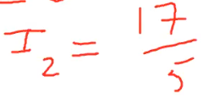
Source Conversion Example
Convert 4 A current source to the voltage source then redraw and solve.

Slide 23
Current Sources in Parallel
We found that voltage sources of different terminal voltages cannot be placed in parallel because of a violation of Kirchhoff’s voltage law.
Similarly, current sources of different values cannot be placed in series due to a violation of Kirchhoff’s current law.

Slide 24
Current Sources in Parallel
However, current sources can be placed in parallel just as voltage sources can be placed in series.
In general, two or more current sources in parallel can be replaced by a single current source having a magnitude determined by the difference of the sum of the currents in one direction and the sum in the opposite direction. The new parallel internal resistance is the total resistance of the resulting parallel resistive elements.

Slide 25
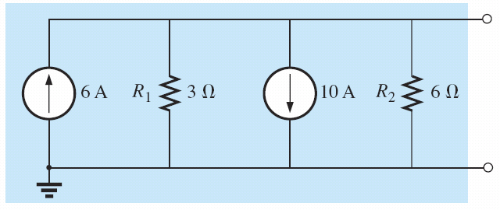
Example
KCL at top node 6A – 10A = -4A (4A heading down)
Total resistance

Slide 26
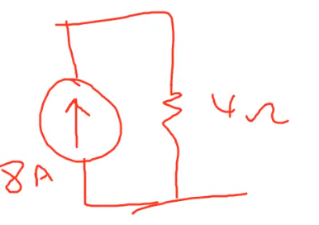
Example 1

Slide 27
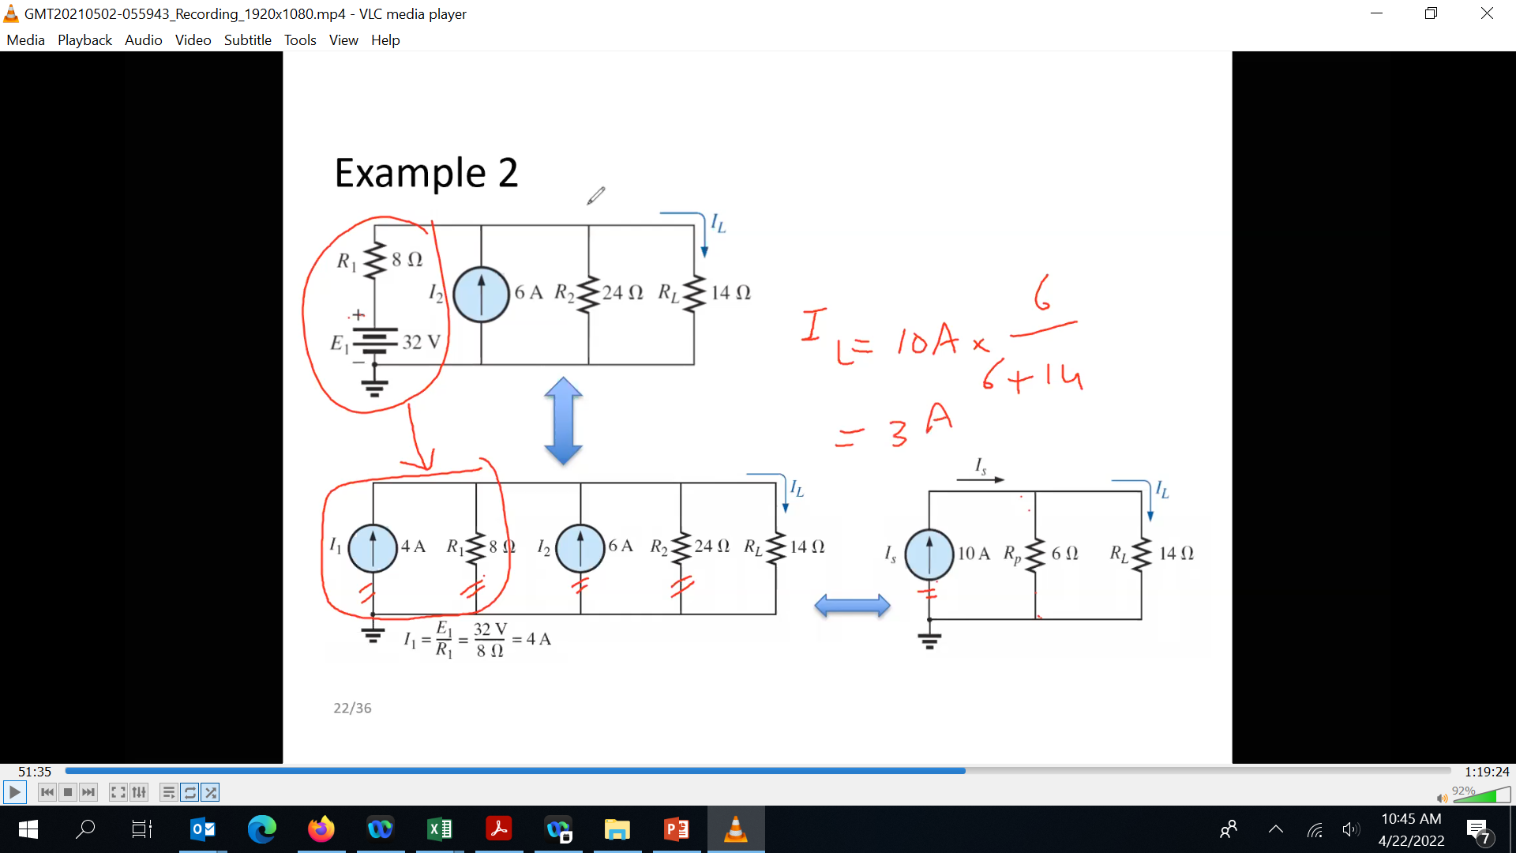
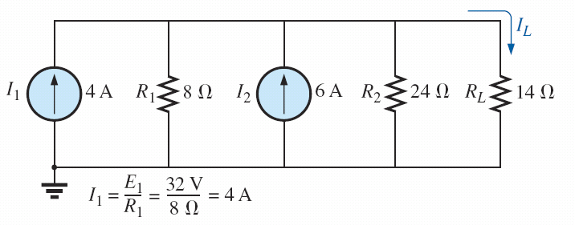

Example 2

Slide 28
Current Sources Can NOT be connected in Series
current sources of different current ratings are not connected in series, just as voltage sources of different voltage ratings are not connected in parallel.

Slide 29
Nodal Analysis
We now turn our attention to nodal analysis—a method that provides the nodal voltages of a network, that is, the voltage from the various nodes (junction points) of the network to ground.
The method is developed through the use of Kirchhoff’s current law in much the same manner as Kirchhoff’s voltage law was used to develop the mesh analysis approach.

Slide 30
Nodal Analysis Method
Determine the number of nodes within the network.
Pick a reference node, and label each remaining node with a subscripted value of voltage: V1, V2, and so on.
Label current directions and polarities.
Apply Kirchhoff’s current law at each node except the reference.
Solve the resulting equations for the nodal voltages.

Slide 31
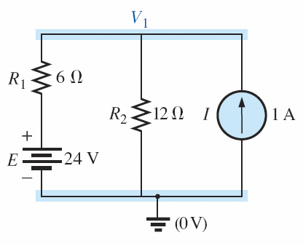
Nodal Analysis by Example
Step 1 and 2: Label the nodes (2 nodes in this case, V₁ and ground 0V)

Slide 32


Example
Step 3: Label current direction and polarities
Step 4: Apply KCL at node V1 1A = I₁+I₂
(or -I₁-I₂+1 = 0 in general terms)
I₁ is just the current through R₁=> use ohms law
I₂ is the current through R₂ => use ohms law
Substitute back into KCL equation

Slide 33
Example with 2 nodes to solve

Slide 34


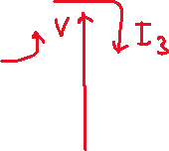
Ctd...
Step 1 and 2 Label nodes
Step 3 directions and polarities
Apply steps 1 and 2 and 3
Step 4: Write KCL at node 1 and KCL on Node 2

Slide 35
Ctd...
solving

Slide 36
Remember Cramer’s rule
...Or use any equation solver

Slide 37
Another Example
V₁ =
V₂ =

Slide 38
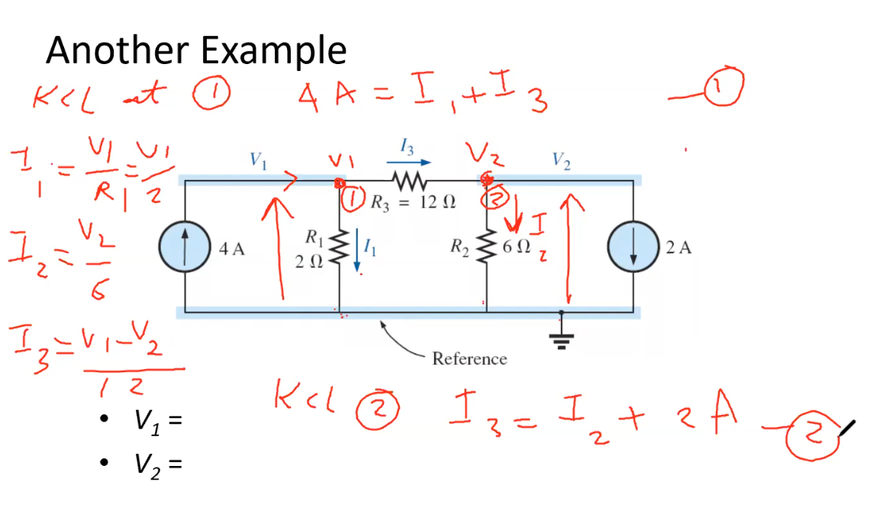

Slide 39
One last example

Slide 40
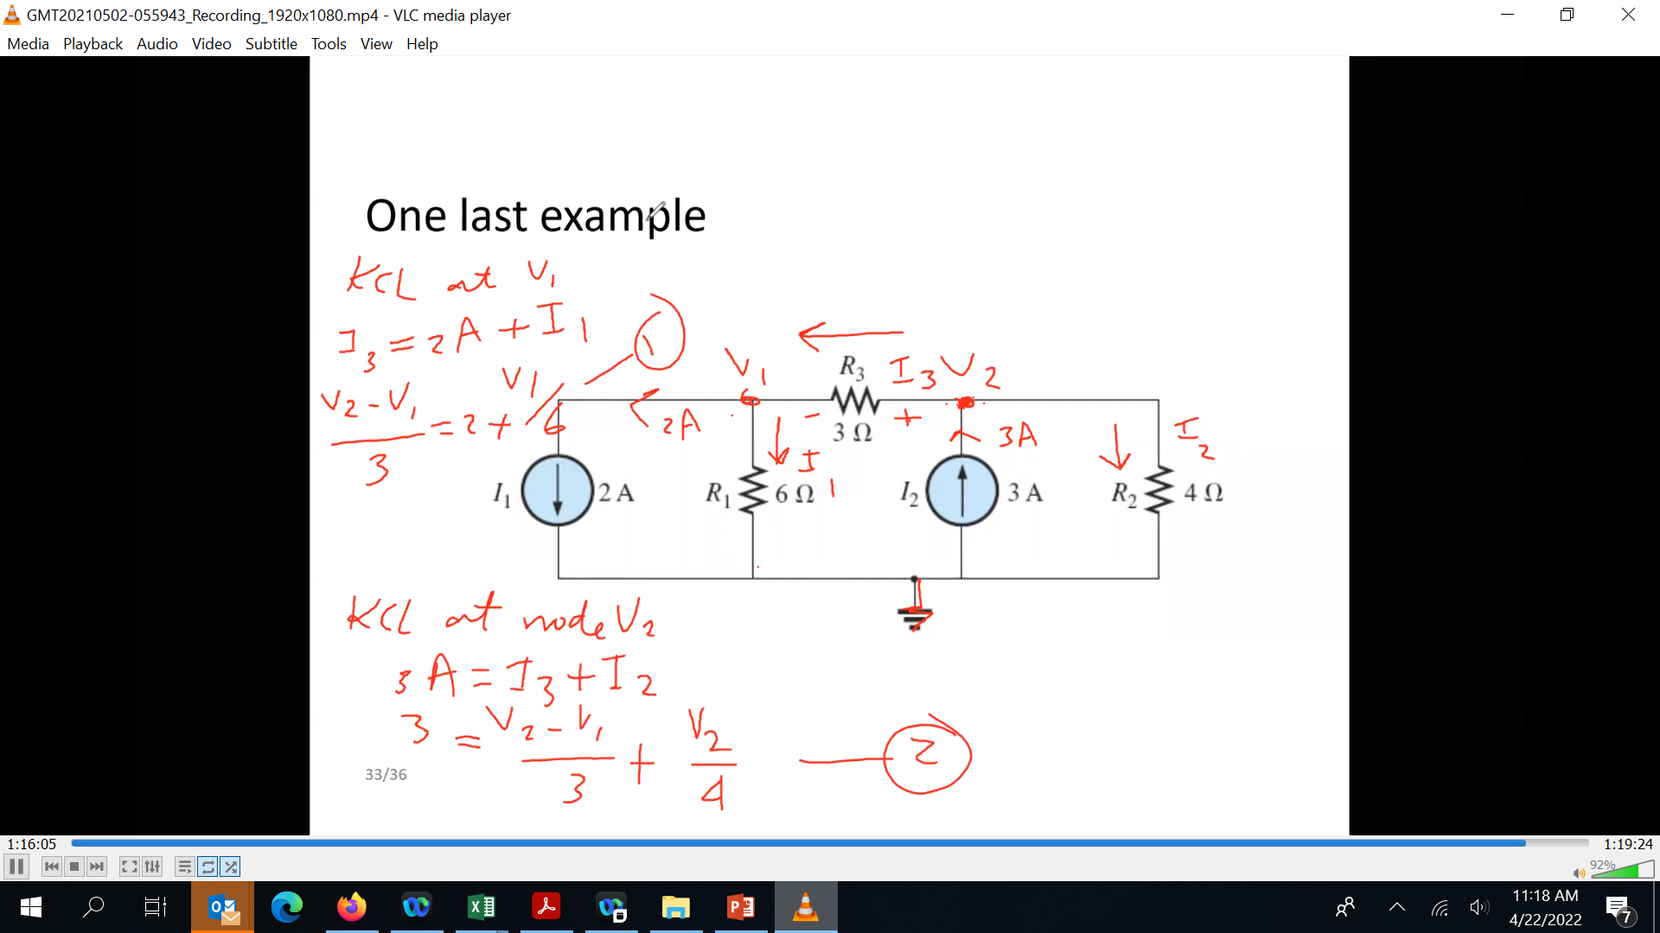

Slide 41
Lecture 4 summary
Series/Parallel Circuits
The current source
Current/voltage source conversion
Nodal analysis

